Slide 1
PRICING AND ADVERTISING
DATA INTELLIGENCE APPLICATIONS
Battistini Camilla
Di Luozzo Giovanni Antonio
Frigeri Michela
Scaramuzza Riccardo

Slide 2


SCENARIO
VegStrenghty, e-commerce in the market of protein and vitamine shakes.
Born to provide aid to vegan people, got appreciated by athletes.
AllMightyShake©: new product designed to address the whole market
Social Advertising: advertising campaign is pursued through Instagram Ads

Slide 3
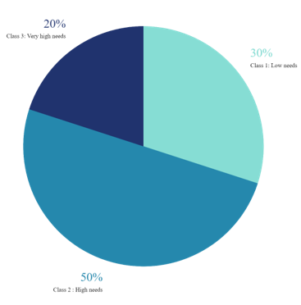
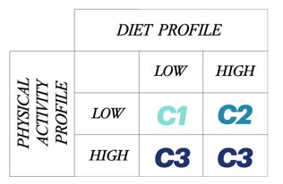
SCENARIO
Market segmentation: three underlying customer classes
Two binary features:
- Diet Profile
- Physical activity Profile

Slide 4
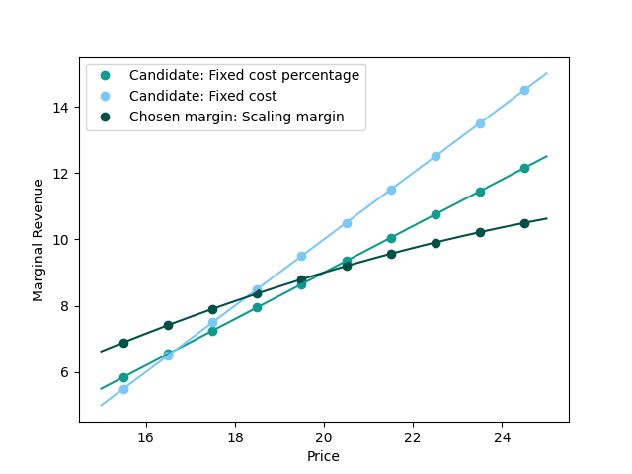

SIMULATED DATA: FUNCTIONS OF THE PRICE
MARGINAL REVENUE FUNCTION
Three candidates:
Pure fixed cost
Fixed and price-percentage cost
"Real-life" designed function

Slide 5
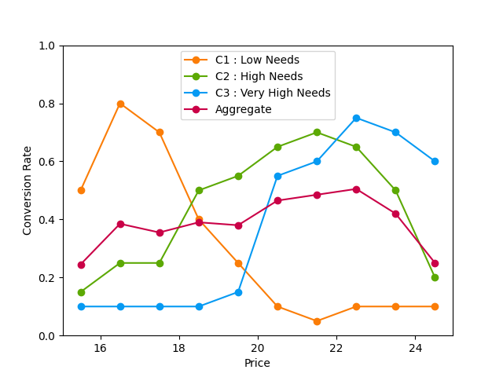
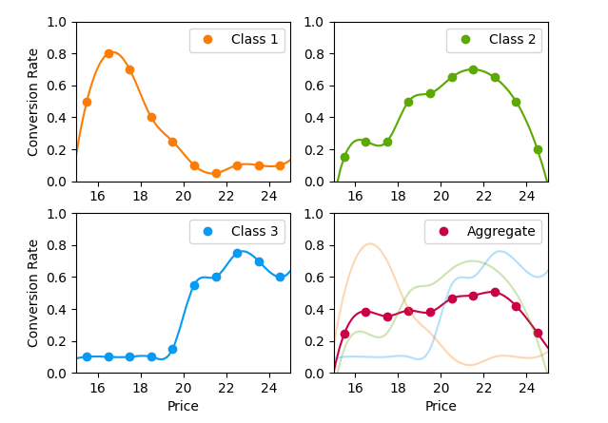
SIMULATED DATA: FUNCTIONS OF THE PRICE
CONVERSION RATE FUNCTIONS
Assumptions:
Class C1 customers are more likely to finalize their purchase if the price is low
Class C3 may consider a cheap price indicative of a not so worthy product
Class C2 follows a behaviour in-between the above

Slide 6
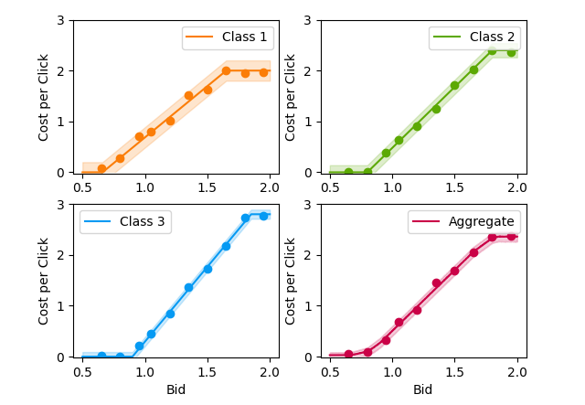
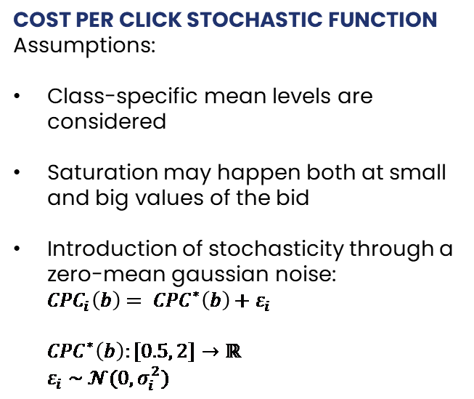
SIMULATED DATA: FUNCTIONS OF THE BID
COST PER CLICK STOCHASTIC FUNCTION
Assumptions:
Class-specific mean levels are considered
Saturation may happen both at small and big values of the bid
Introduction of stochasticity through a zero-mean gaussian noise:
${CPC}_{i}\left(b\right)= {CPC}^{∗}\left(b\right)+ε_{i}$
${CPC}^{∗}\left(b\right):[0.5, 2]→ℝ$
$ε_{i} \sim 𝒩(0,σ_{i}^{2})$

Slide 7
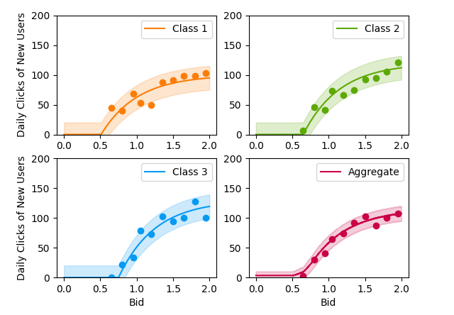
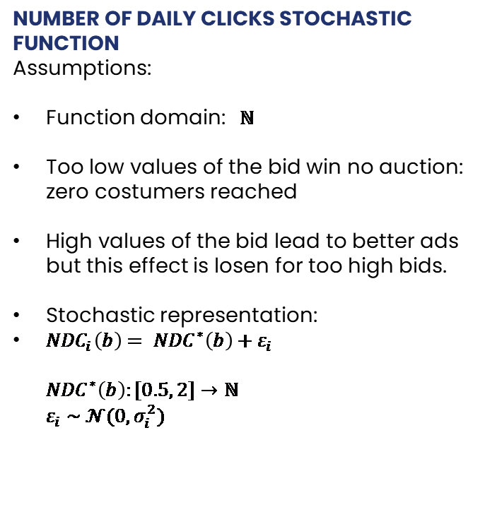
SIMULATED DATA: FUNCTIONS OF THE BID
NUMBER OF DAILY CLICKS STOCHASTIC FUNCTION
Assumptions:
Function domain: $ℕ$
Too low values of the bid win no auction: zero costumers reached
High values of the bid lead to better ads but this effect is losen for too high bids.
Stochastic representation:
${NDC}_{i}\left(b\right)= {NDC}^{∗}\left(b\right)+ε_{i}$
${NDC}^{∗}\left(b\right):[0.5, 2]→ℕ$
$ε_{i} \sim 𝒩(0,σ_{i}^{2})$

Slide 8
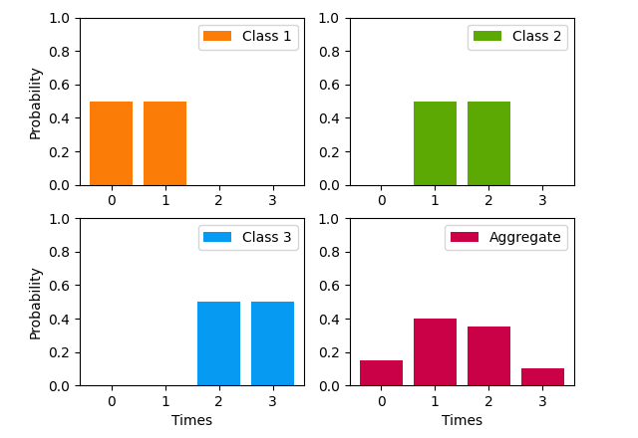
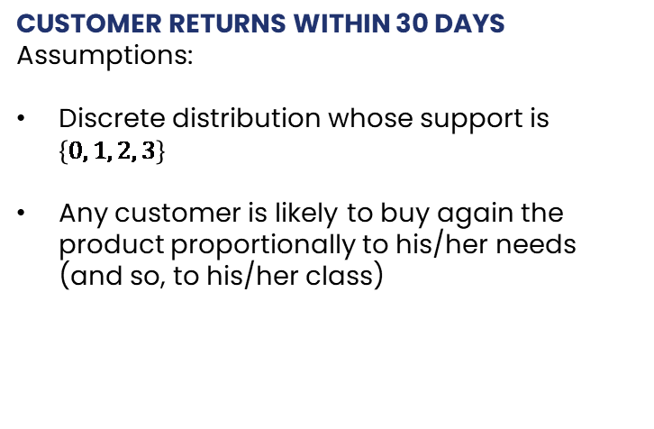
SIMULATED DATA
CUSTOMER RETURNS WITHIN 30 DAYS
Assumptions:
Discrete distribution whose support is $\left\{0, 1, 2, 3\right\}$
Any customer is likely to buy again the product proportionally to his/her needs (and so, to his/her class)

Slide 9
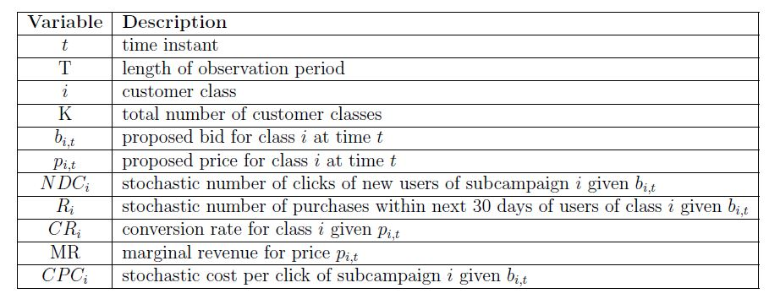
OPTIMIZATION PROBLEM
GENERAL FORMULATION

Slide 10
OPTIMIZATION PROBLEM
AGGREGATED DATA
CONTEXTUAL PRICING

Slide 11
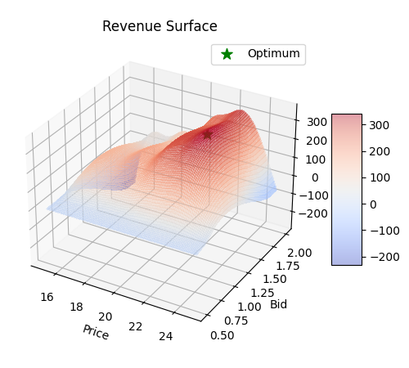

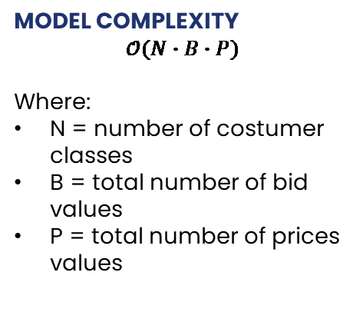
OPTIMIZATION PROBLEM
BRUTE FORCE SOLUTION
Candidates
MODEL COMPLEXITY
$$𝒪(N∙B∙P)$$
Where:
N = number of costumer classes
B = total number of bid values
P = total number of prices values
Aggregated Opt solution

Slide 12
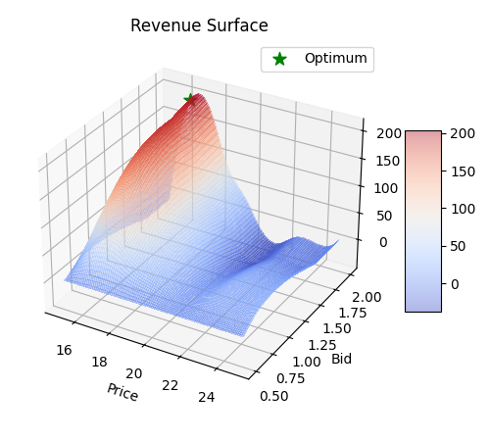
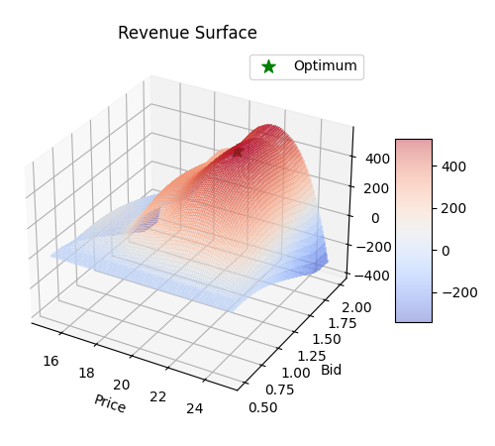
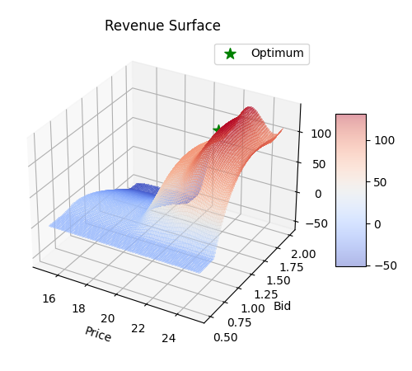
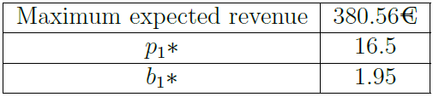
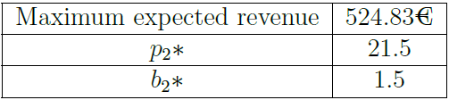
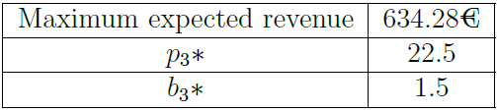
OPTIMIZATION PROBLEM
BRUTE FORCE SOLUTION
Class 1 opt. solution
Class 2 opt. solution
Class 3 opt. solution

Slide 13
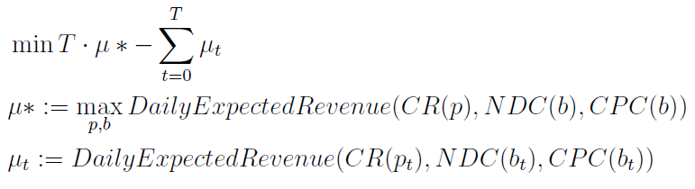
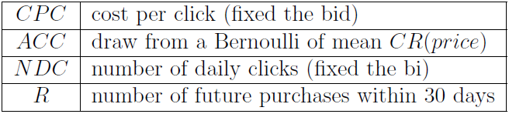
OPTIMIZATION PROBLEM: ONLINE-LEARNING
Random Variables
Time horizon: 365 days
Potential delays in the feedback
Algorithm: MAB
WHAT WE OBSERVE
MAB’s MATHEMATICAL FORMULATION

Slide 14
FIXED BID AND ONLINE PRICING
ASSUMPTIONS​
We consider the aggregated case in which no contextual pricing is applied
We consider the value of mean returns to be known
Bid related values are considered as fixed
ENVIRONMENT
The environment is modeled by using a binomial sampler
LEARNER
Thompson Sampling and UCB1 learners modified for a Binomial reward
What the learner registers is the expected daily revenue, computed using daily rewards

Slide 15
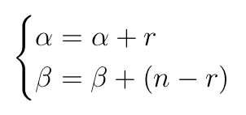
FIXED BID AND ONLINE PRICING
TS-ALGORITHM
Updated parameters at the end of the day using the realization of a binomial distribution
UCB1-ALGORITHM
It works as the classical one, but it performs the update of parameters necessary to compute the upper Hoeffding bound in a batch manner.
Number of daily positive realizations
Total number of daily costumers

Slide 16
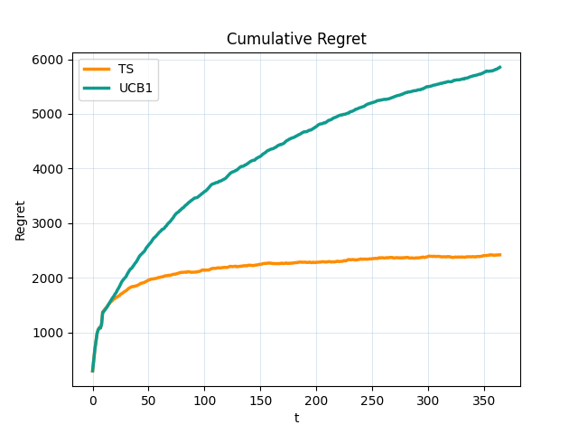
FIXED BID AND ONLINE PRICING
• Cumulative Regret, to identify the better performing algorithm
• Daily Expected Revenue, to understand if the algorithm actually converges to the optimum value.
PERFORMANCE METRIC
We repeat 100 times a one year simulation in order to obtain the estimate of:
PERFORMANCE EVALUATION
Both learners show sublinear Cumulative Regret
TS achieves much better performances

Slide 17
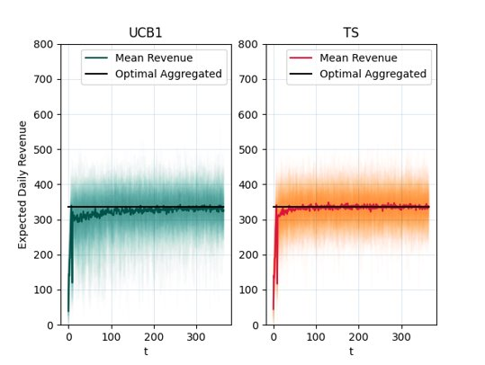
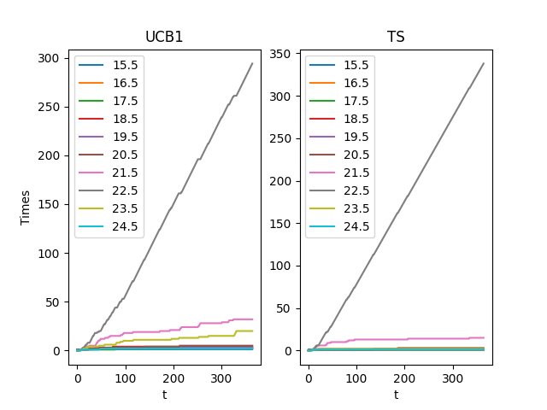
FIXED BID AND ONLINE PRICING
PERFORMANCE EVALUATION
Fast convergence for both learners
TS achieves perfect convergence to the optimum value; UCB1 seems to converge to slightly suboptimal policy

Slide 18
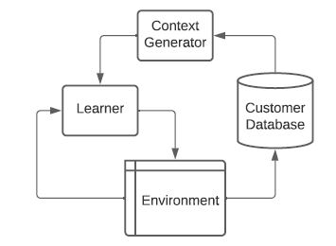
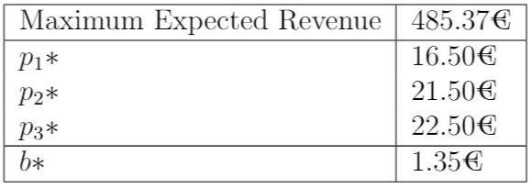
FIXED BID AND CONTEXTUAL PRICING
OPTIMAL SOLUTION
Different price to each
true underlying class

Slide 19
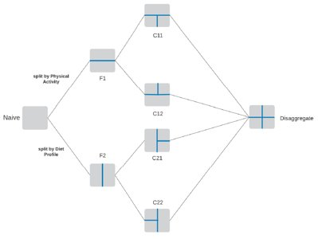

FIXED BID AND CONTEXTUAL PRICING
IMPLEMENTATION
Customer
Feature Generation
Context Mapping
Context Generators
Naïve
Brute Force
Greedy

Slide 20
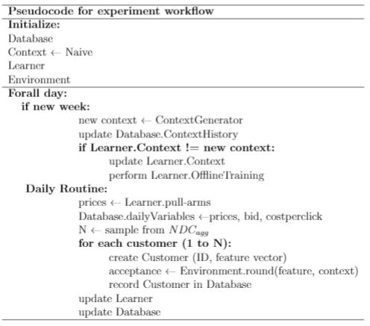
FIXED BID AND CONTEXTUAL PRICING
IMPLEMENTATION
Customer Database
Daily variables
Collection of daily customers
Context history
Mean Returns Estimation
Learners
TS & UCB1
Offline-Training

Slide 21
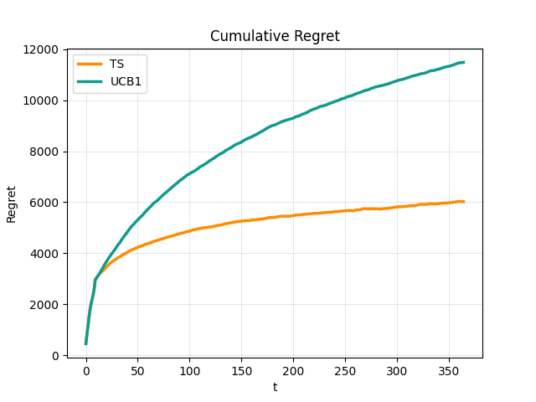
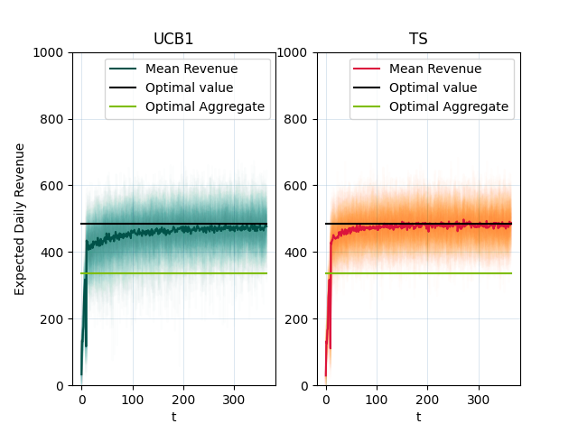
FIXED BID AND CONTEXTUAL PRICING
PERFORMANCE EVALUATION

Slide 22
FIXED PRICE AND ONLINE BIDDING
ASSUMPTIONS
No budget constraint
No class diversification wrt bidding
Price related values considered as fixed
ENVIRONMENT​
At each round:
Samples values of NDC and CPC according to the given bid
Compute the revenue expression using the sampled values
LEARNER
MAB setting with a bid value for each arm
10 candidates (possible bid values)
Models Considered: - Gaussian TS (GTS) - Gaussian Process TS (GPTS)

Slide 23


FIXED PRICE AND ONLINE BIDDING
GTS
Same as TS Algorithm, but on the bid values
Prior and Sampling distributions assumed to be Gaussian
GPTS
Using Gaussian Process as a regressor to model the Revenue distribution, assuming: - Zero mean GP - covariance function: squared exponential kernel function $k\left(x, x^{′}\right)$ plus a white noise:
Mean and Variance are updated according to the daily collected revenue.

Slide 24
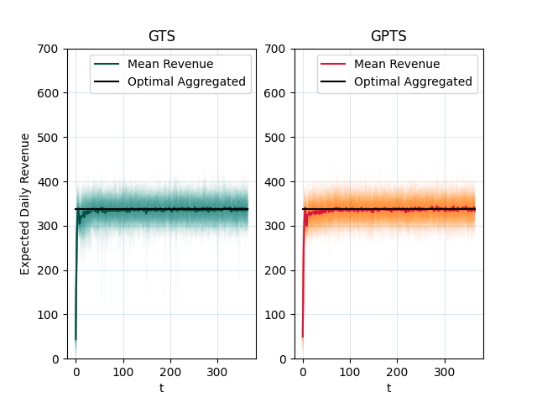
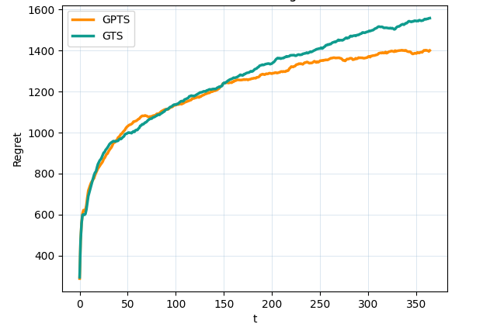
FIXED PRICE AND ONLINE BIDDING
PERFORMANCE EVALUATION

Slide 25
JOINT BIDDING & PRICING
We now want to apply the two algorithms sequentially in order to discover the
optimal joint bidding-pricing strategy.
ADVERTISING :
GPTS selects a bid value at the beginning of each day (according to collected data)
The environment samples NDC and CPC values according to the bid value
PRICING :
TS selects the price value for the day
The environment decides for each user if they accept to buy at given price
Given the full simulation of the day , the expected daily revenue can be computed.
GPTS and TS parameters are updated at the end of each day, according to the collected revenue.

Slide 26
JOINT BIDDING & PRICING
GPTS pulls the bid and let the environment samplethe related variables
TS pulls the price to let the environment sample the price related variables
Bid arm
NDC and CPC
GPTS
ENVIRONMENT
TS
Price arm
Both learners update their parameters according to the daily revenue and the procedure is repeated for the next day

Slide 27
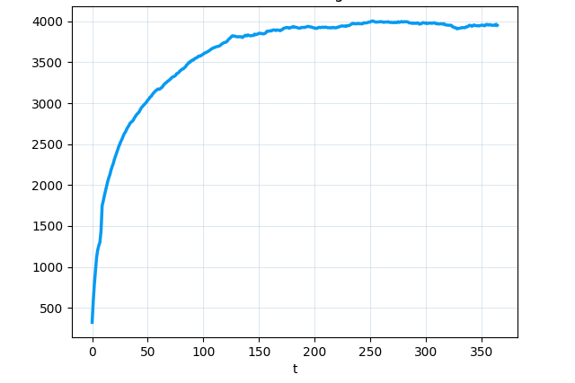
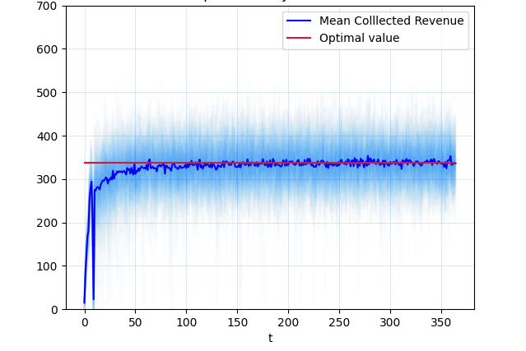
JOINT BIDDING & PRICING
PERFORMANCE EVALUATION

Slide 28
JOINT BIDDING & CONTEXTUAL PRICING
CONTEXTUAL SCENARIO
ASSUMPTIONS
Same mechanism as before for each day
Context diversification only wrt pricing
Each day the drawn price is proposed to the 3 classes (context C12)
The optimal context is assumed to be known beforehand

Slide 29
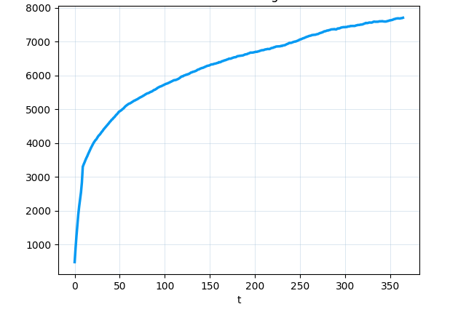
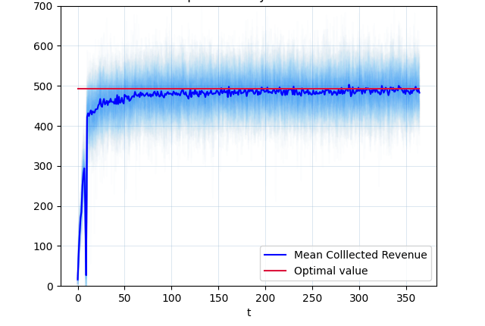
JOINT BIDDING & CONTEXTUAL PRICING
PERFORMANCE EVALUATION

Slide 30
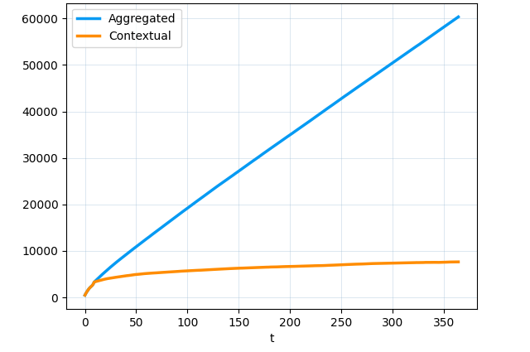
CONCLUSIONS
Aggregated Optimum: EDR = 337.9 €
Contextual Optimum: EDR = 492.5 €
Contextual solution has a slower convergence that may lead to a loss
Comparing regrets computed wrt the highest revenue possible (492.5 €) it's clear that the contextual algorithm overcomes the aggregated one

